Slide 1

Understanding the Crucial Role of Version Control in DevOps
Name : Abhiram Nagam
Regd. num : 211FA04562

Slide 2

Outline
Understanding Version Control
Understanding DevOps
GitHub and DevOps

Slide 3

"Version control is the backbone of DevOps, enabling streamlined collaboration and efficient code management."

Slide 4

What is DevOps?
DevOps is a software development approach that combines development and operations teams to enhance collaboration and streamline the software delivery process.
DevOps emphasizes automation, continuous integration, and continuous deployment to achieve faster and more reliable software releases.

Slide 5

What is Version Control?
Version control is like a boss that keeps track of all the changes you make to your files. It's super handy because it saves a record of every modification, so you can easily go back to previous versions, check out what's different, and work together with your team.
Common version control tools (e.g., Git, SVN)

Slide 6


Slide 7

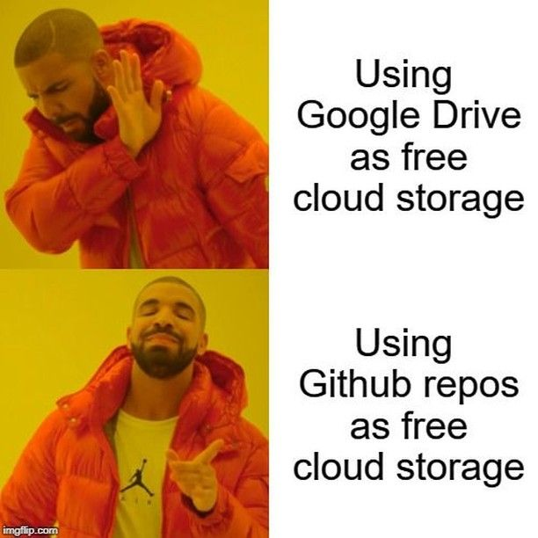

Slide 8

GitHub and DevOps
Overview of GitHub
GitHub as a version control platform
Integrating GitHub into DevOps workflows

Slide 9

Conclusion:
By incorporating these principles of vcs, devOps and leveraging tools like GitHub, we empower our teams to collaborate efficiently, innovate effectively, and deliver software products that meet the highest standards of quality and competitiveness. Let's continue to explore, learn, and implement these practices in our projects, ensuring our success in the dynamic world of software development.

